Slide 1
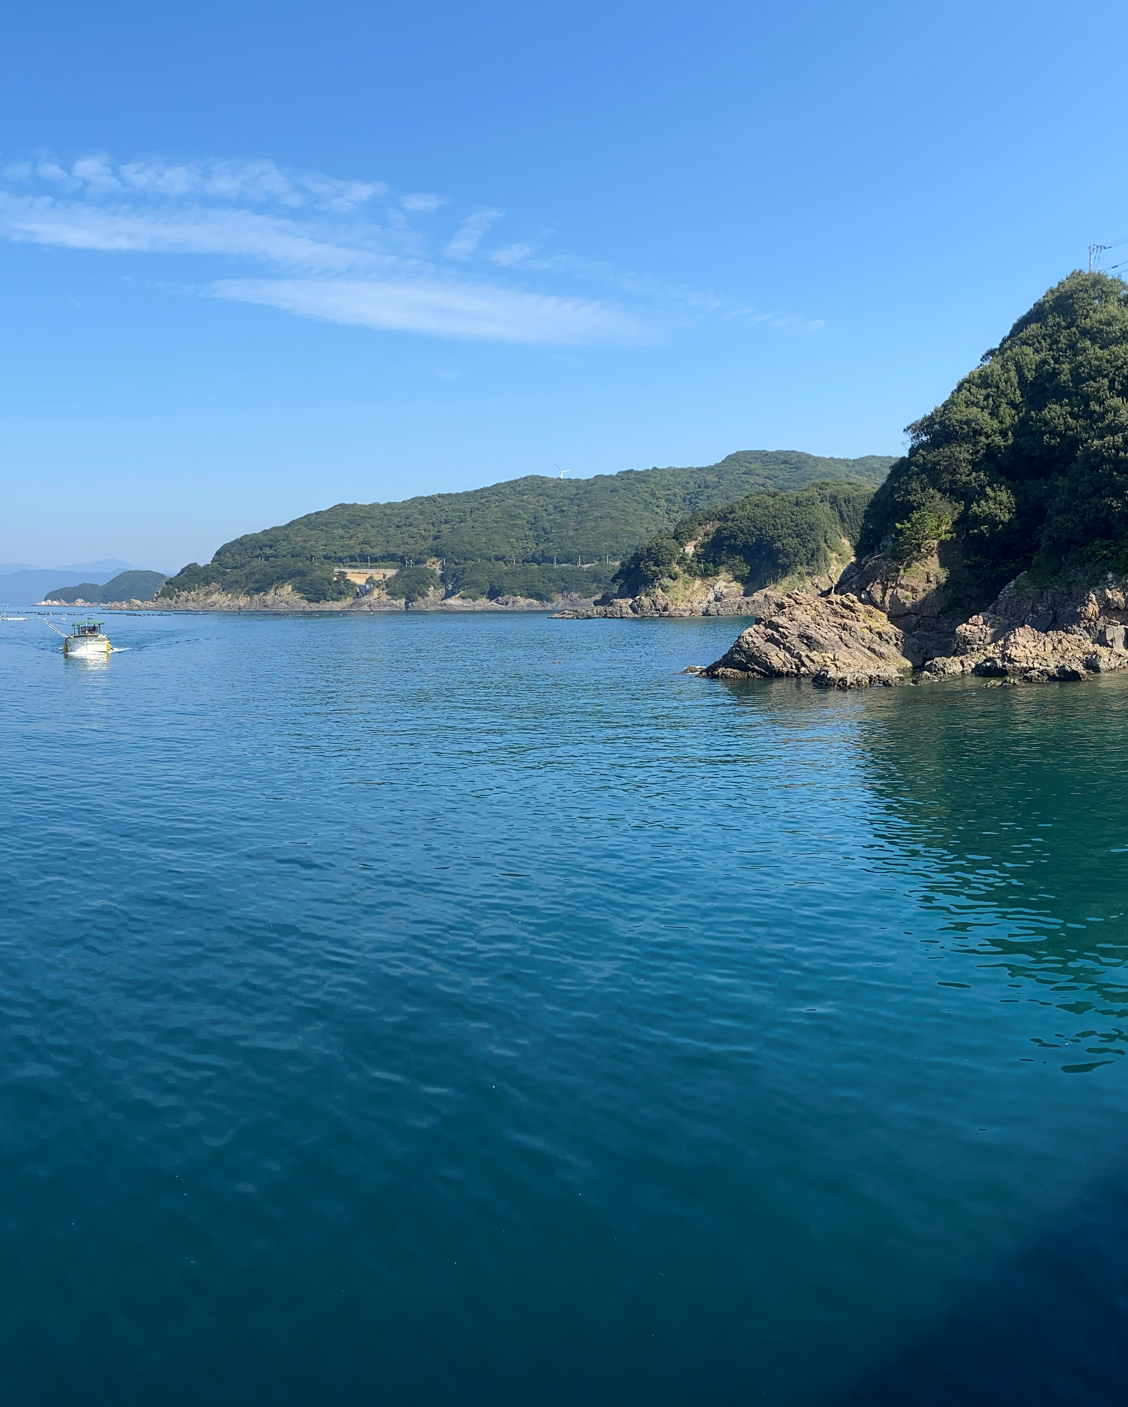


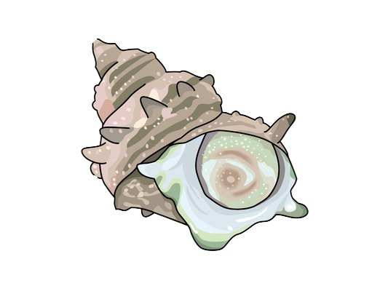
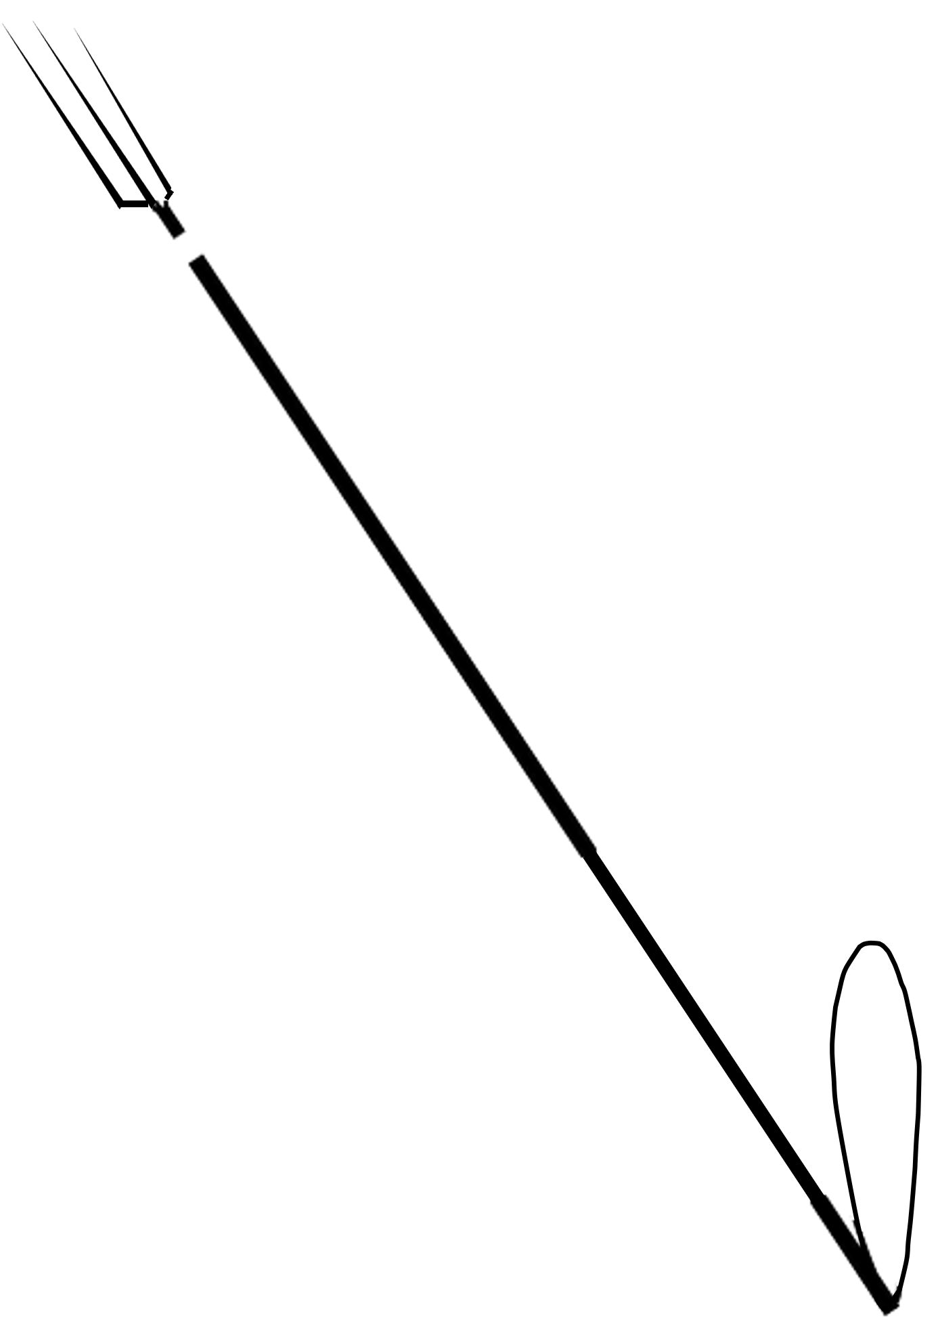
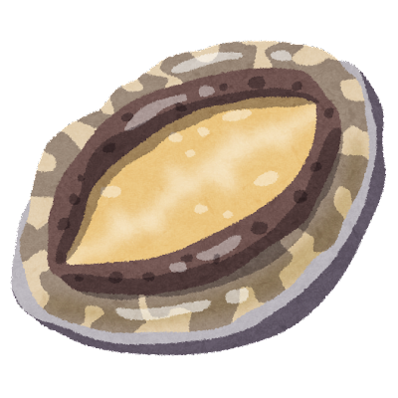
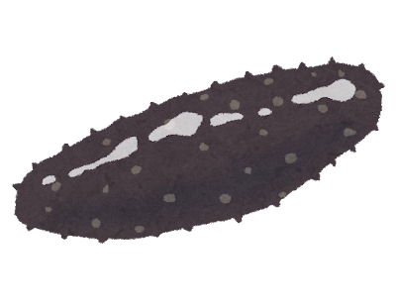
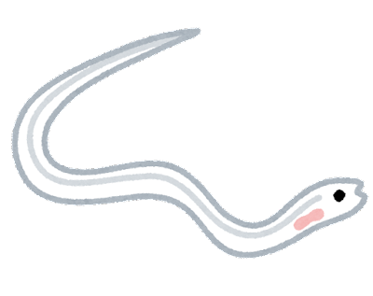

To all recreational fishermen
Poaching is an acting that seriously affects fisheries resources.
Violators can be imprisoned for up to three years or fined up to 30 million yen, depending on seriousness of the offence (※Fishery Act, Article 132) .
Comply with following rules and enjoy recreational fishing.
In the area fishing rights have been established, no recreational fishing are allowed to take any of the aquatic plants or animals listed in the right.
○○、○○、○○・・・・・・・・・・・・・
2. Fishing gear and fishing methods available
to recreational fishing are limited to
the following. ○○、○○、○○・・・・・・
3. Catching of designated aquatic animals and
plants ( eels smaller than 13 cm, abalones,
and sea cucumbers ) is prohibited.
(※Fishery Act, Article 132)
For more information, please contact
○○○○
Phone number：○○○－○○○－○○○

